Slide 1
Data-driving modelling of hydrometeorological processes and beyond
❙ Li-Pen Wang (lpwang@ntu.edu.tw)
❙ feat. Wang Up team
Computational Hydrometeorological Lab
Department of Civil Engineering, National Taiwan University
CAE Admission Briefing
10th Sep 2025

Slide 2






Li-Pen Wang, PhD
PhD in Civil & Env. Engineering, Imperial College London (2008-2012)
MSc in Computer Aided Engineering, National Taiwan University (2003-2005)
BSc in Civil Engineering, National Taiwan University (1999-2003)
Education
Associate Professor, National Taiwan University (2025/09-now)
Expert Consultant, IMF (2024-now), UK Met Office (2022-now)
Postdoctoral Researcher, Imperial College London, KU Leuven
Head of CAT unit, Microinsurance Catastrophe Risk Organisation
Founder/Director/Hydrometeorologist, Rain++ Ltd.
Professional
Experience
Research Areas
Hydrometeorology
Remote Sensing
Computational Statistics

Slide 3
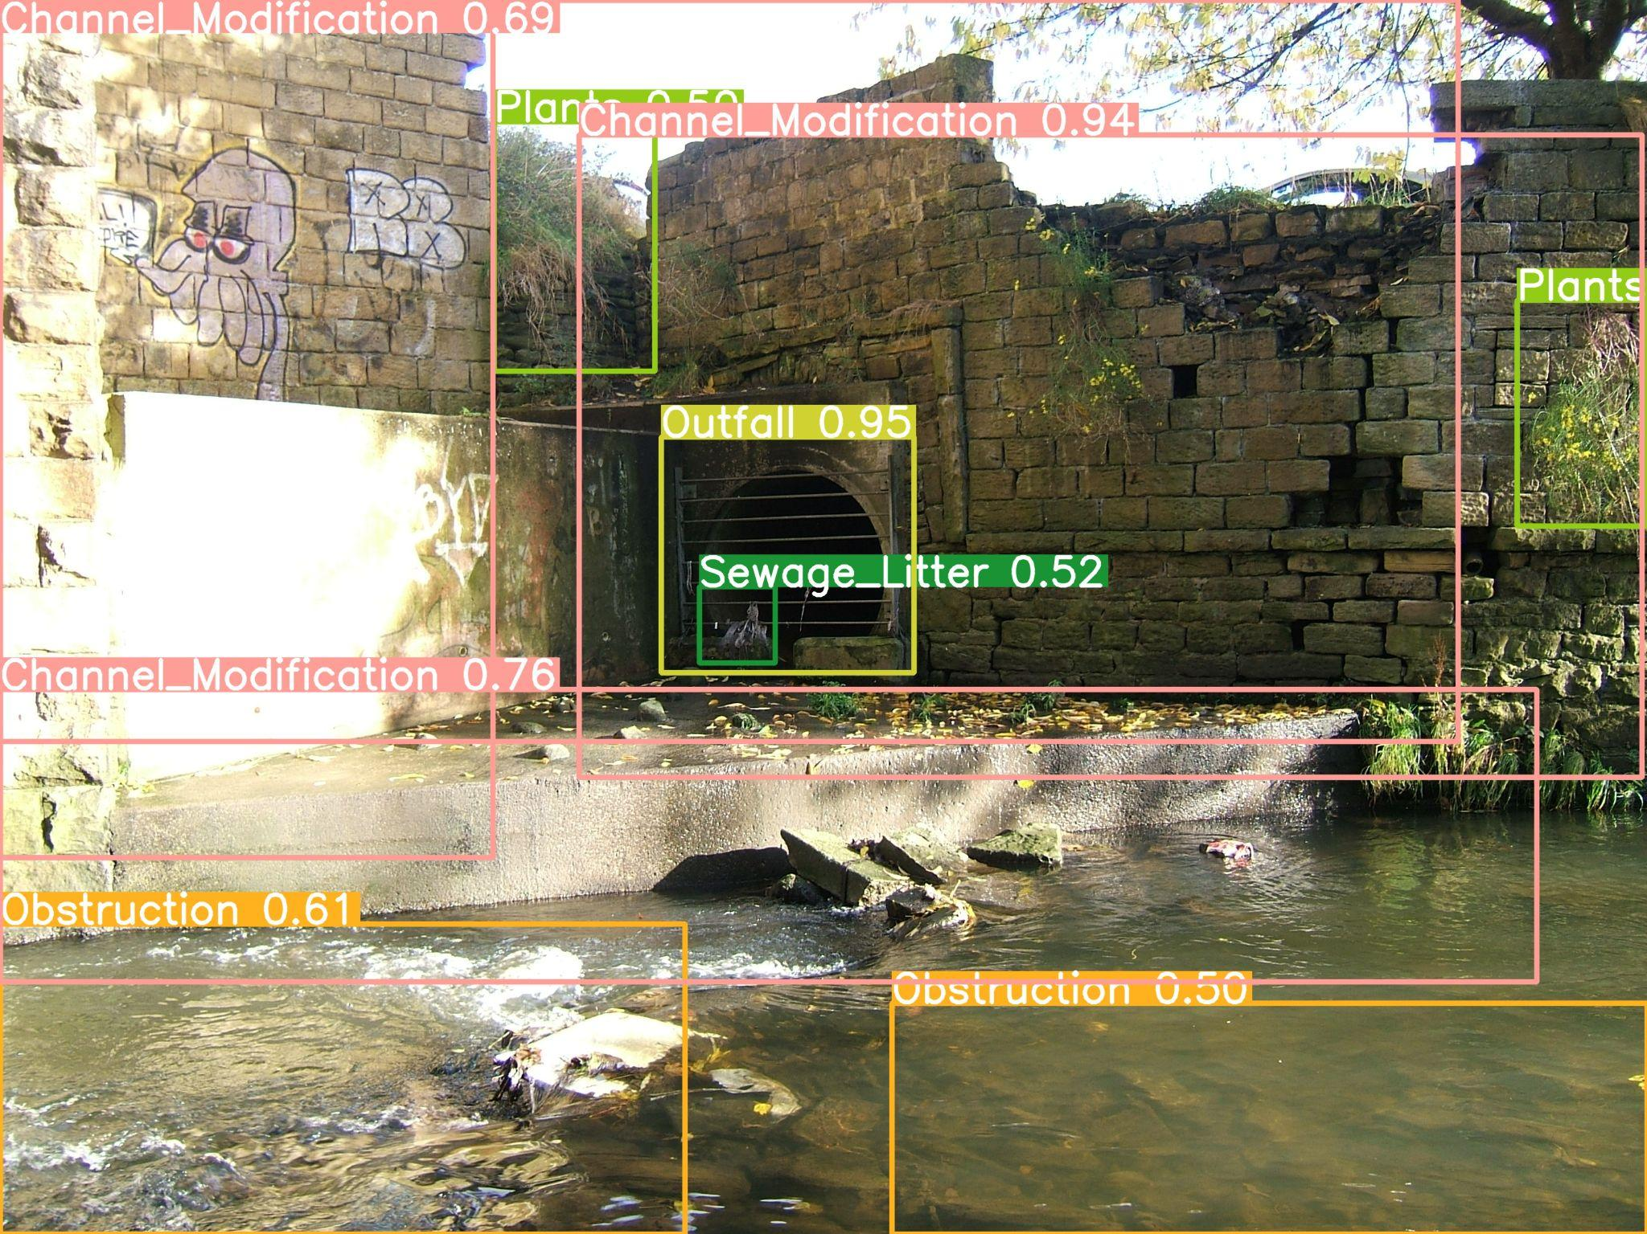
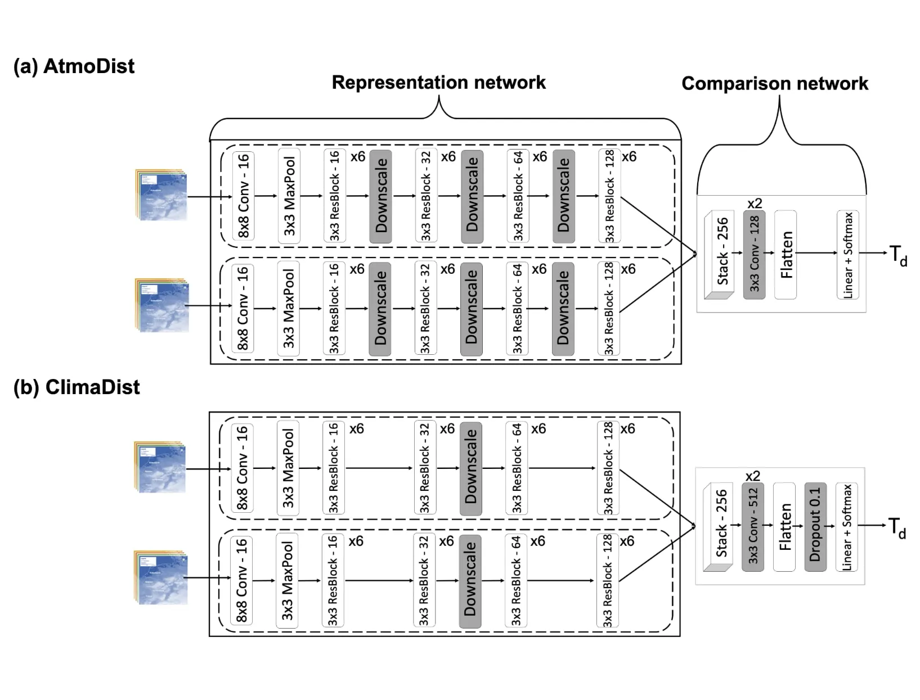
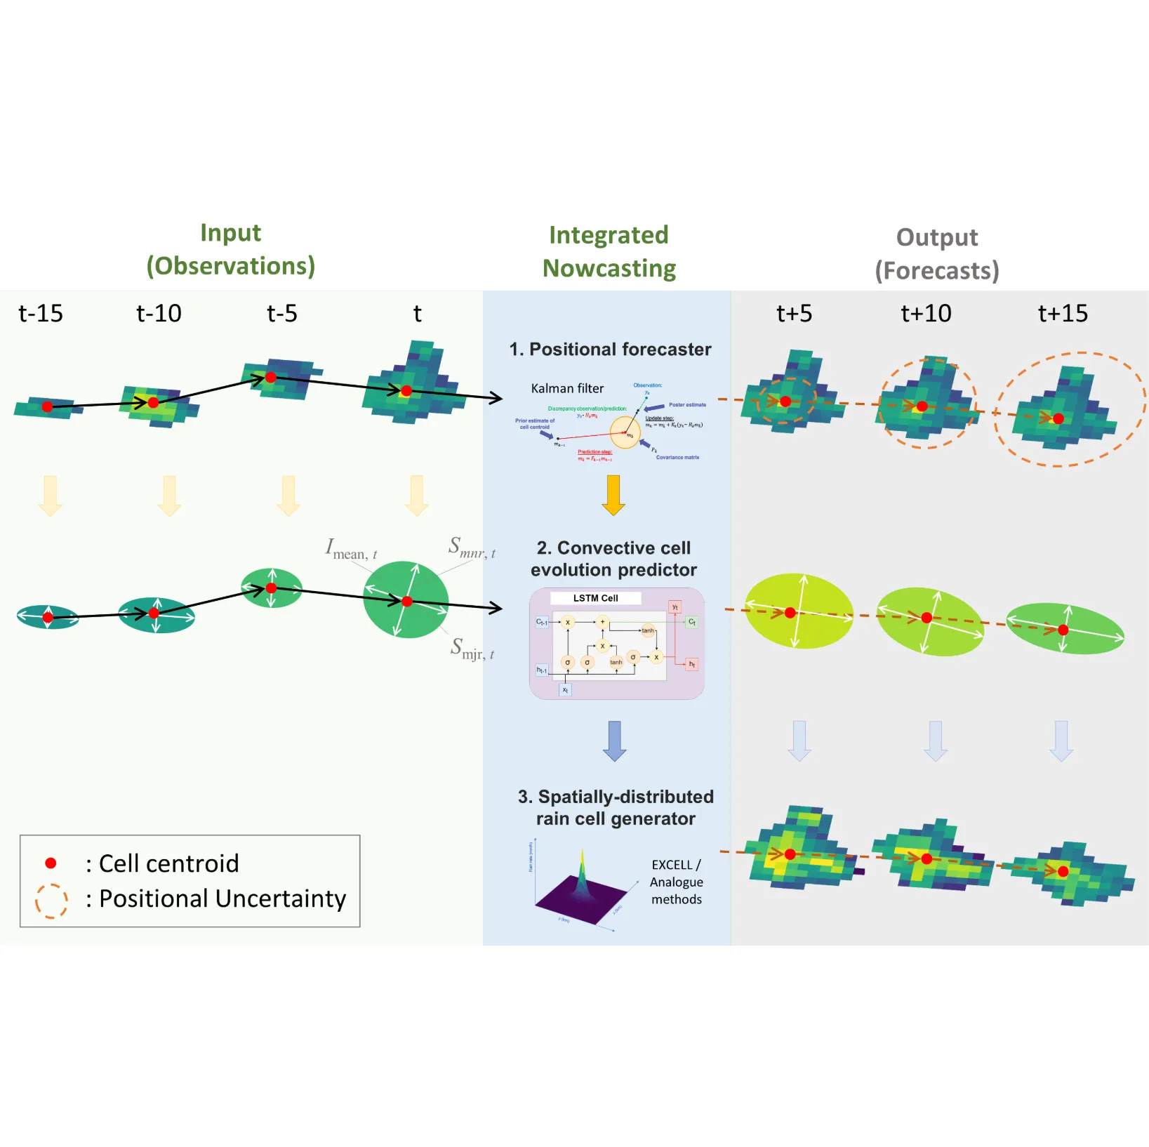
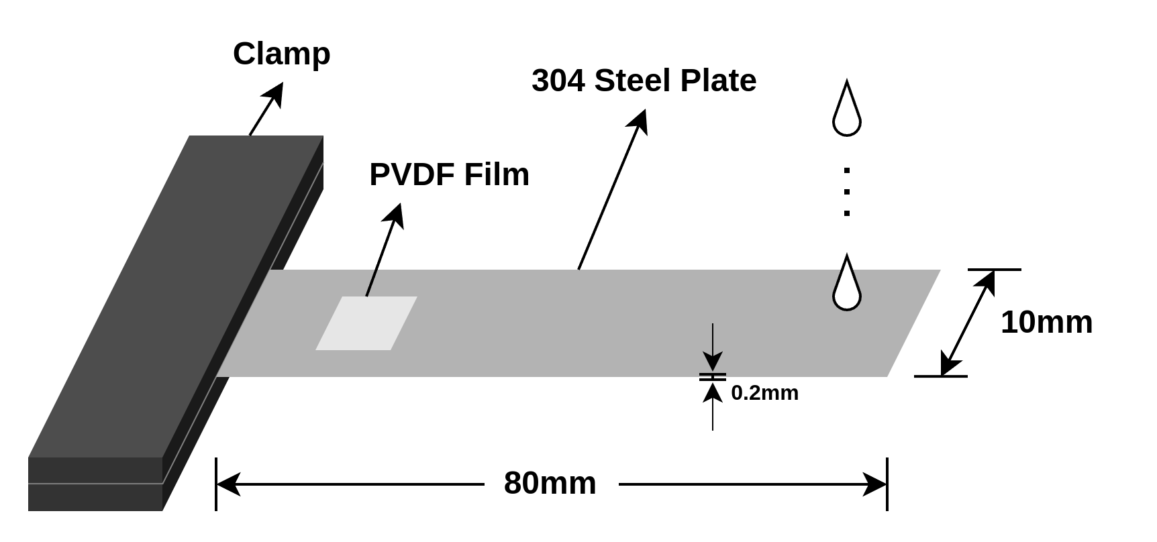
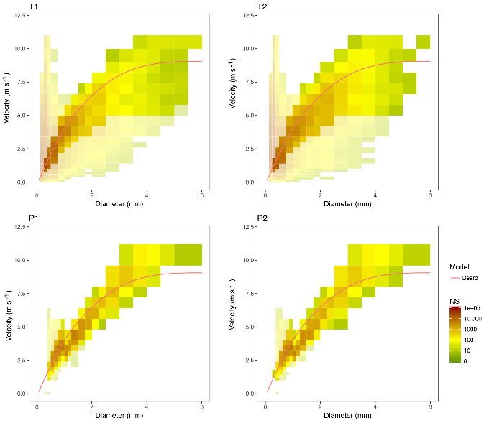
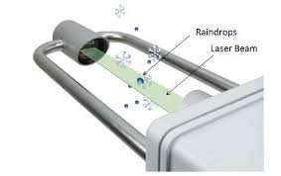


Computational Hydrometeorology Lab (計算氣象水文實驗室 )
Unconventional Environmental Monitoring Solutions
Modelling climate change impacts at local scales
Convective Storm Nowcasting & Modelling
Learn more about
CompHydroMetLab!
Visit our
Github
實驗室成員: 4.5博士生、7碩士生、4大學部專題生、5碩士畢業。
Unconventional
environmental
monitoring solutions
Convective storm
nowcasting & modelling
Incorporating impact of
climate changes to
local rainfall modelling

Slide 4
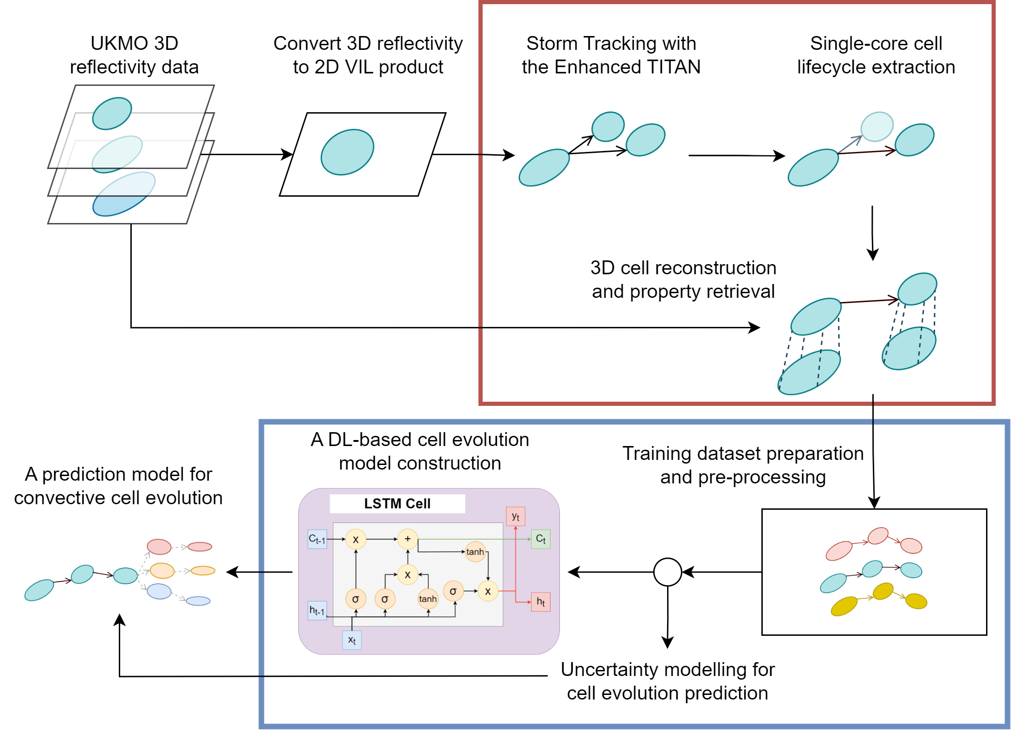
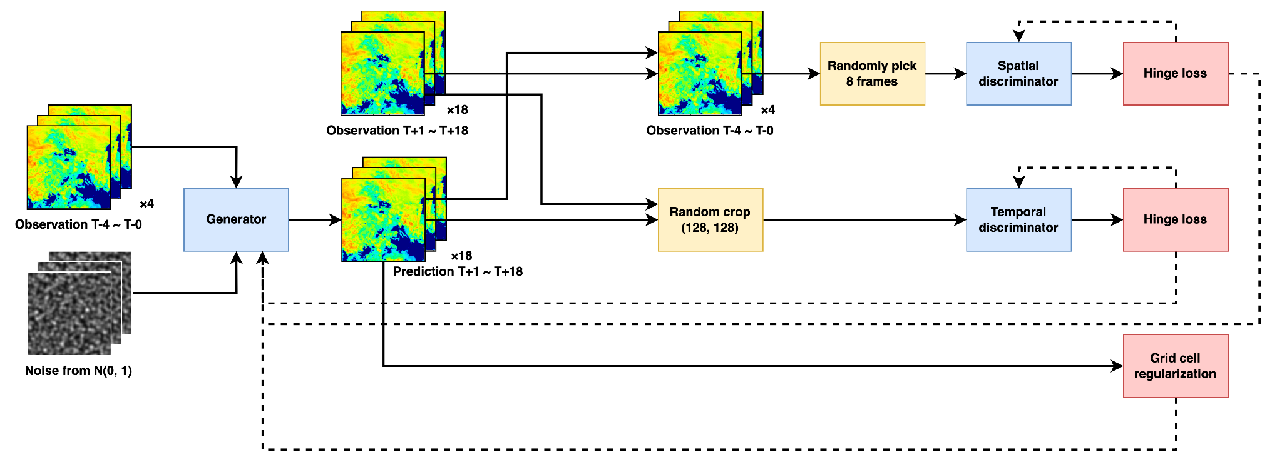
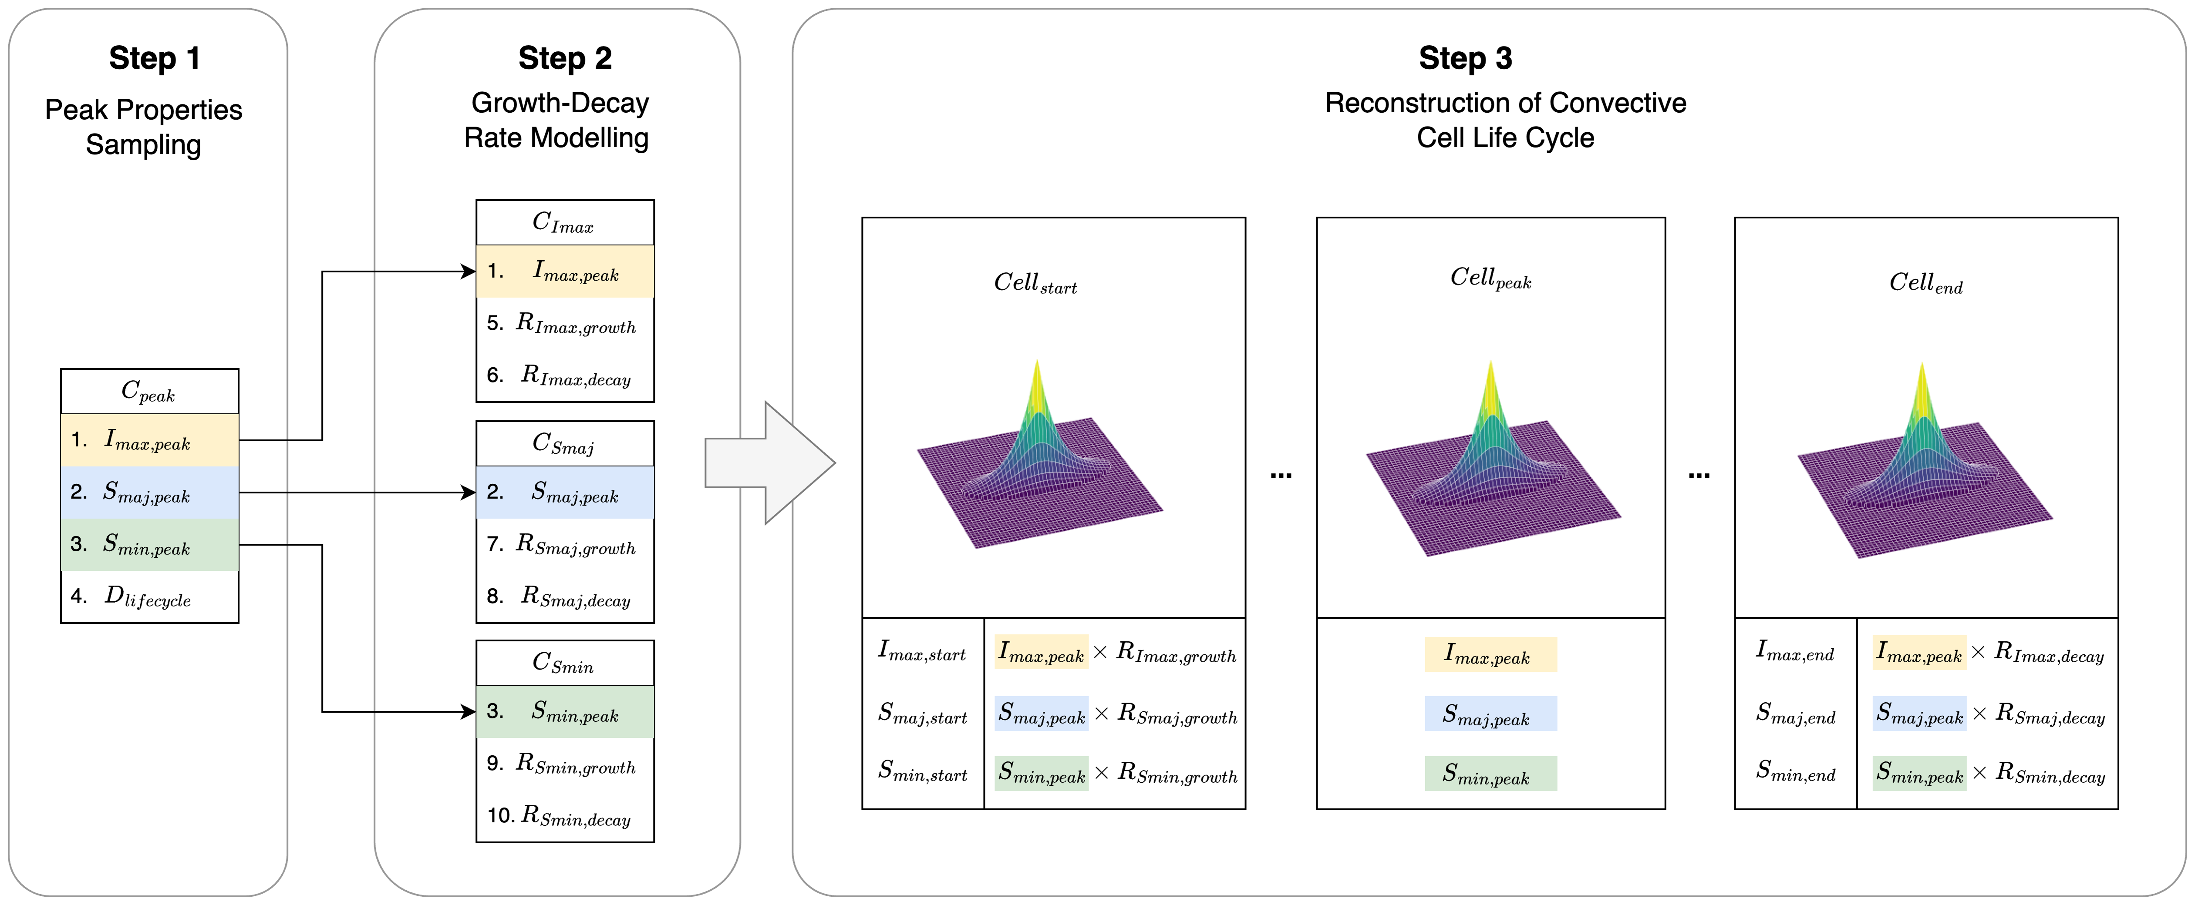
Track 1: Convective Storm Nowcasting & Modelling
對流暴雨短延時預測與模擬
Modelling and predicting the advection and evolution of convective storms using advanced statistical and AI techniques
https://doi.org/10.1016/j.atmosres.2024.107380
https://doi.org/10.5194/hess-29-1-2025
https://doi.org/10.5194/egusphere-egu25-5282

Slide 5
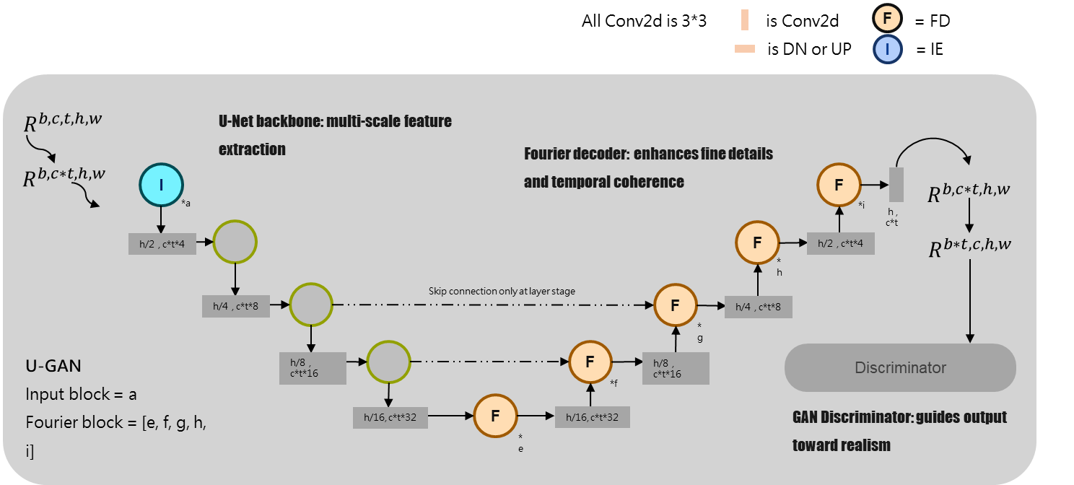
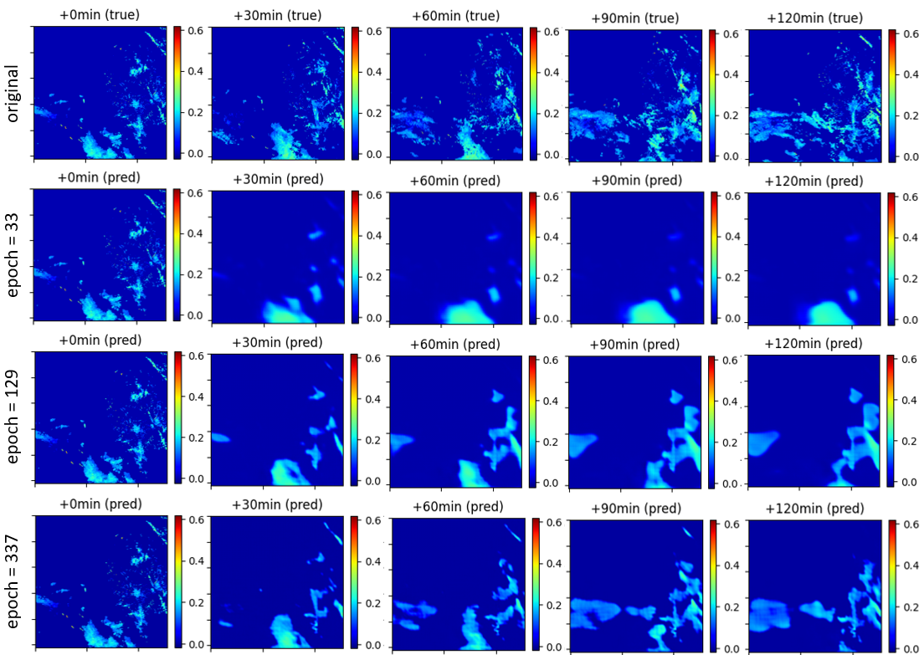
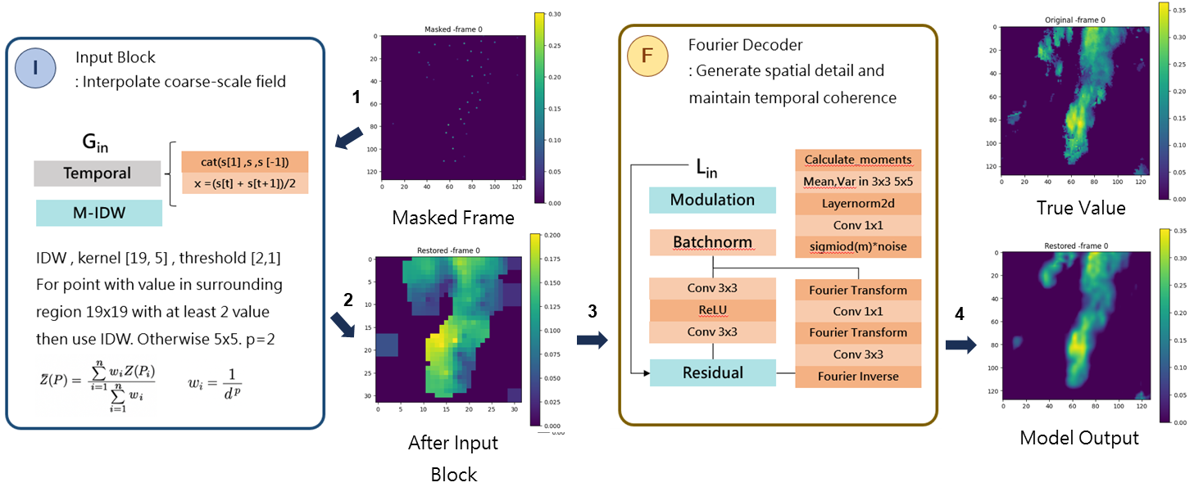
Track 1: Research Challenges
How to preserve fine structure in rainfall nowcasting?
How to reconstruct spatial-temporal rainfall processes with <1% ground observations.

Slide 6
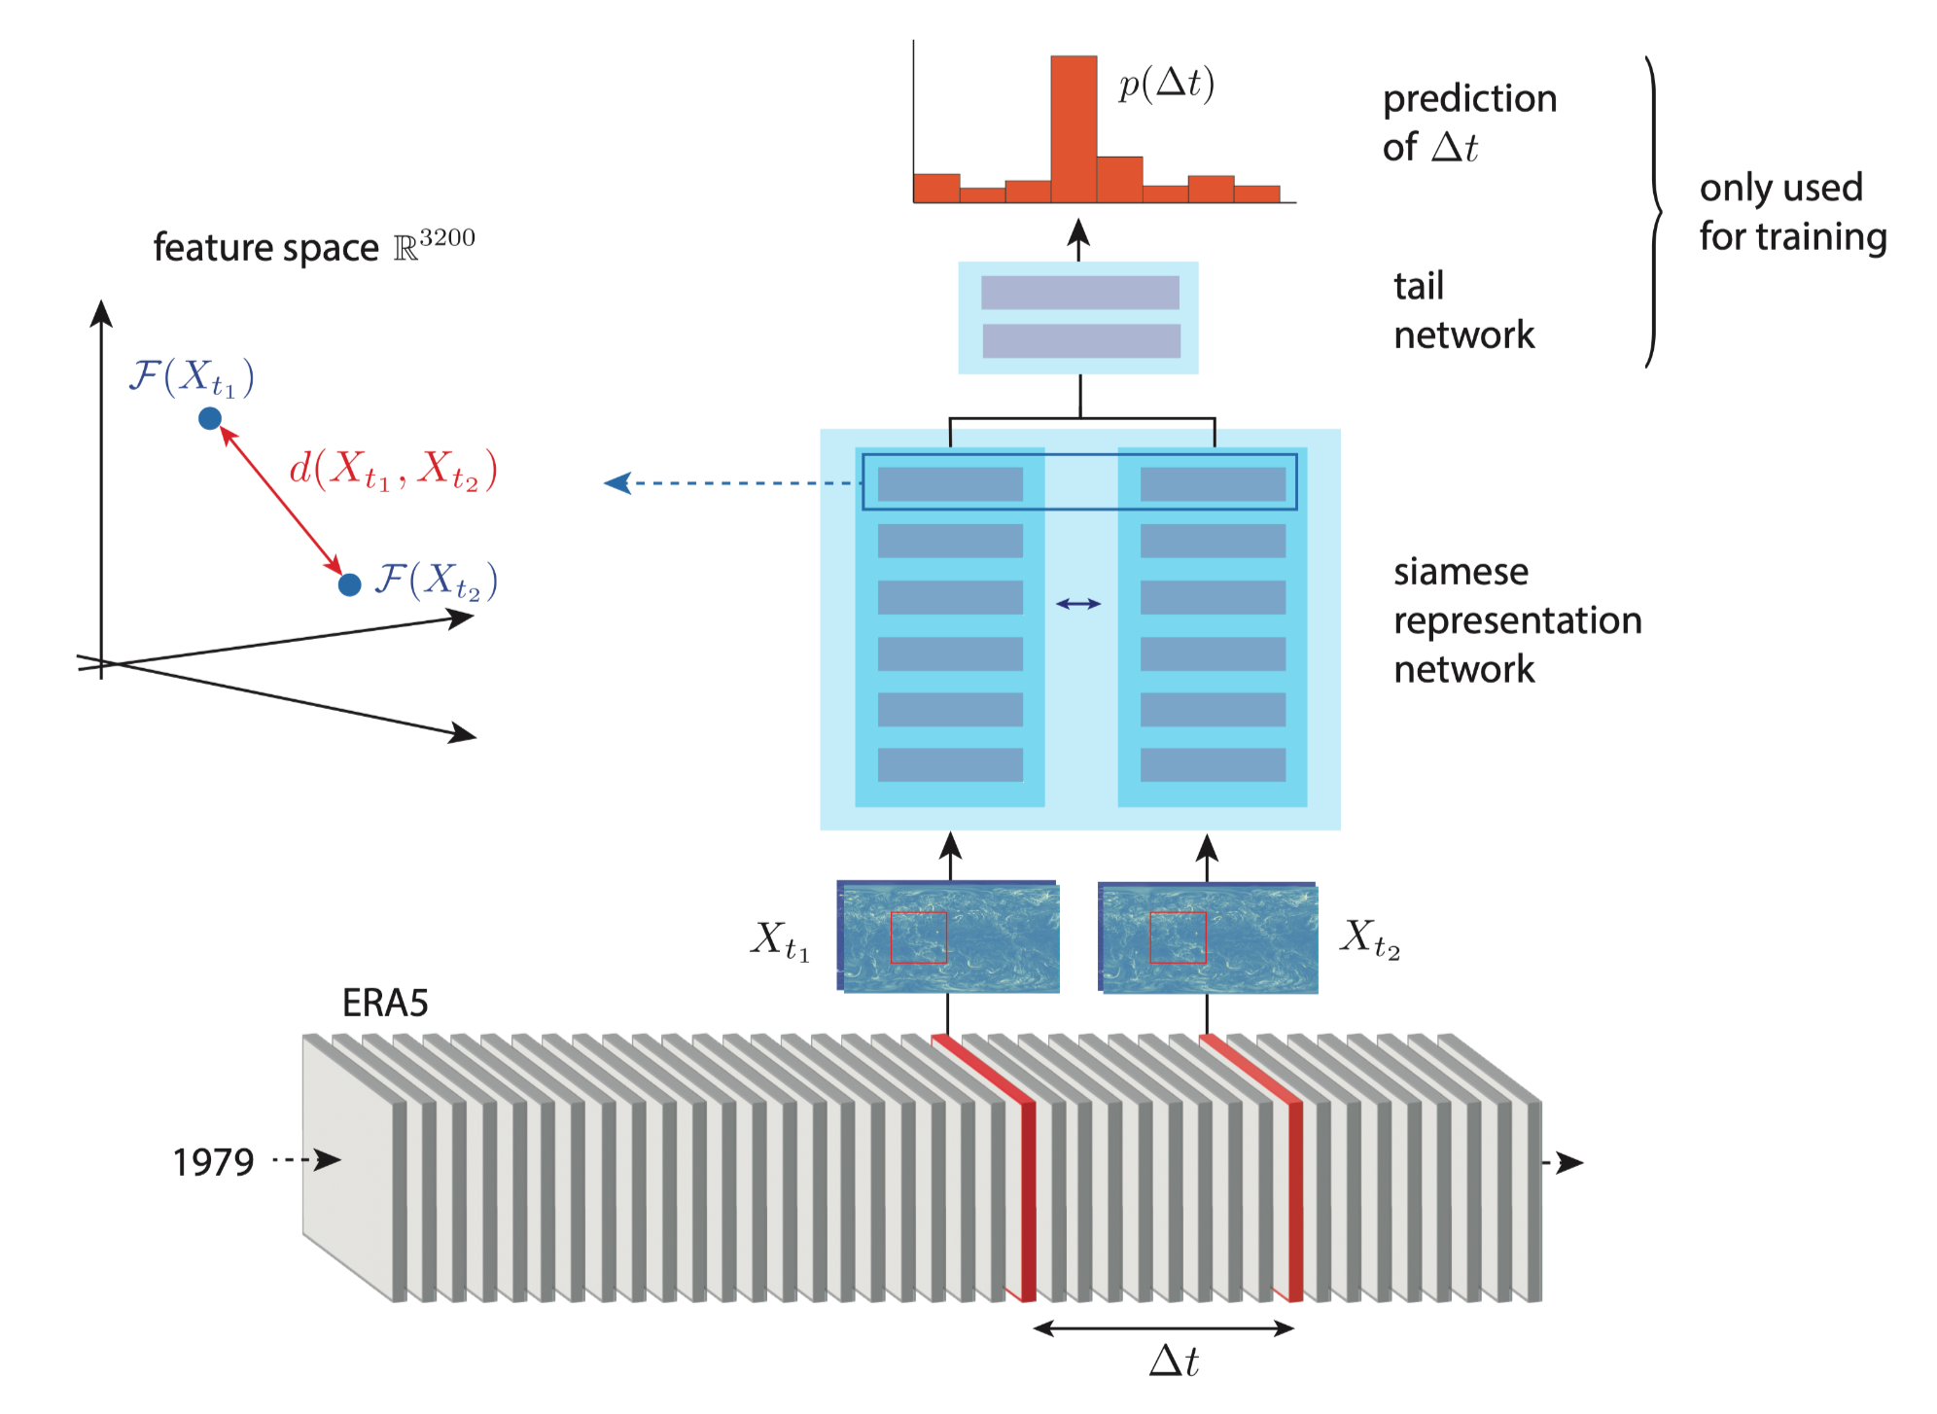
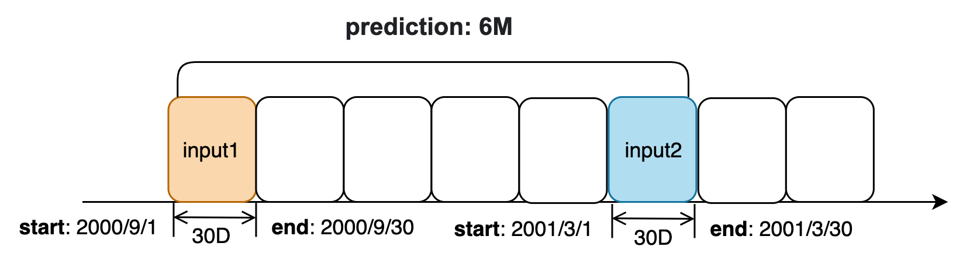
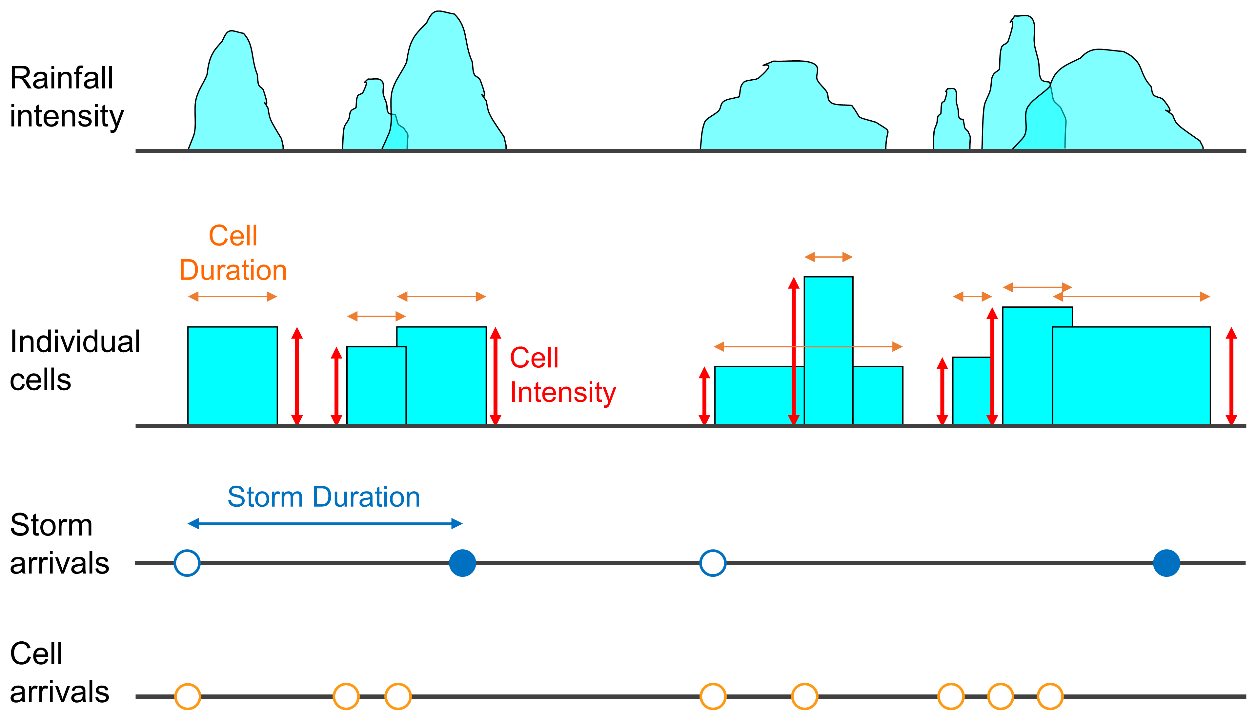
Track 2: Modelling climate change impacts at local scales 動態氣候環境下之時空降雨模擬
Data-driven approaches for modelling climate dynamics and the associated impact and uncertainty to local (extreme) rainfall properties
https://doi.org/10.5194/gmd-18-1357-2025
https://doi.org/10.5194/hess-24-2791-2020
https://doi.org/10.21203/rs.3.rs-5382842/v1
https://doi.org/10.5194/egusphere-egu25-3610

Slide 7
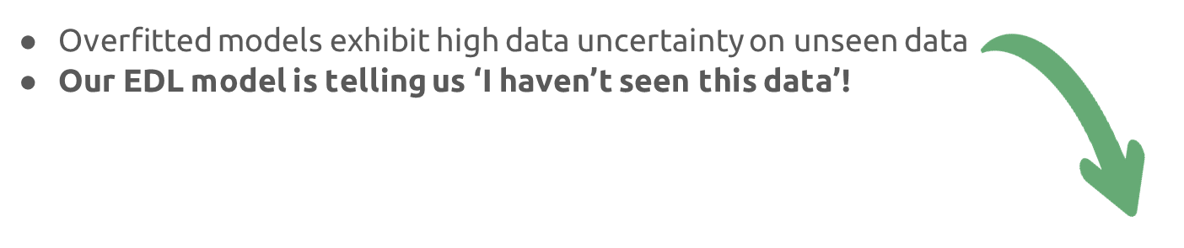
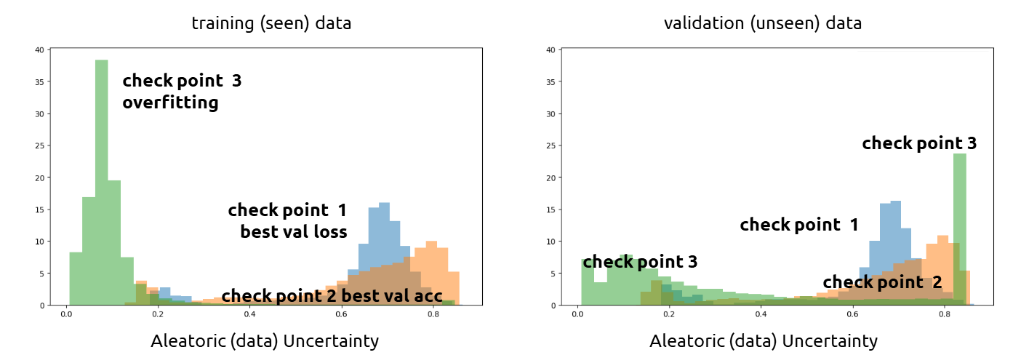
Track 2: Research Challenges
How to quantify uncertainty from AI-based climate modelling?
How to teach AI models say ‘I don’t know!’

Slide 8
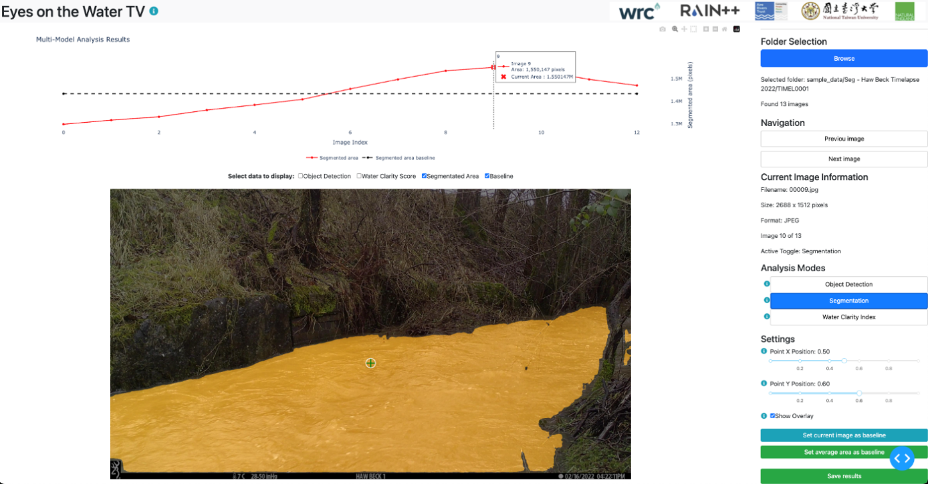
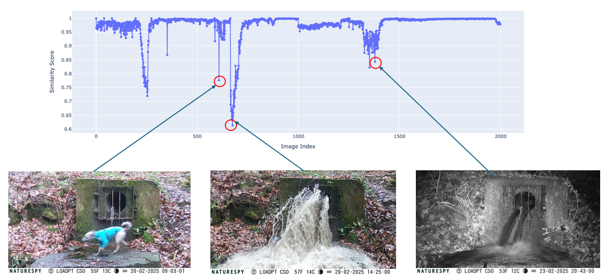
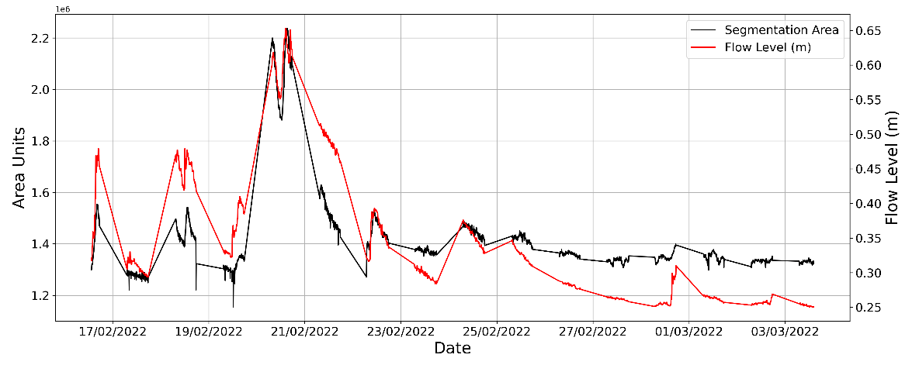
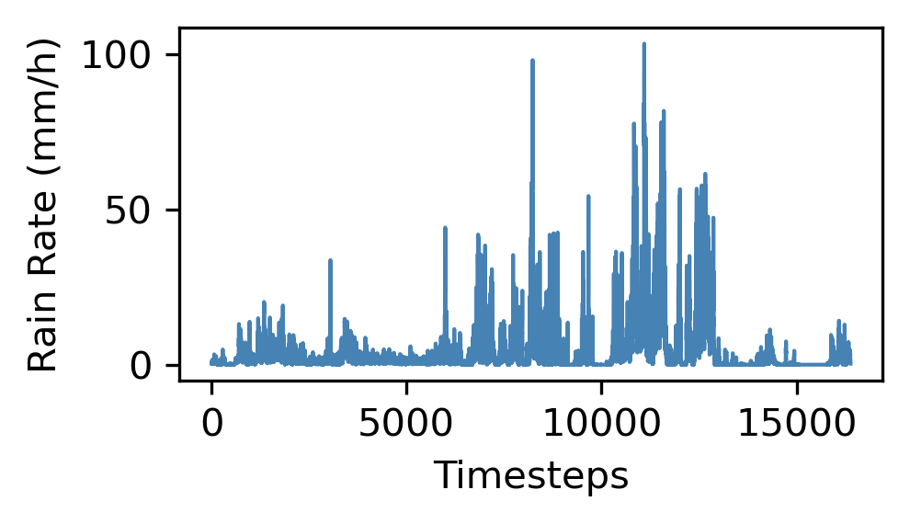
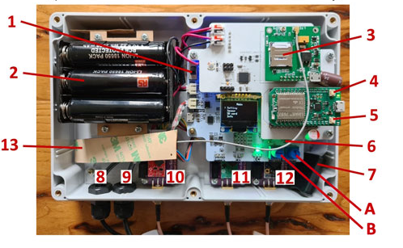
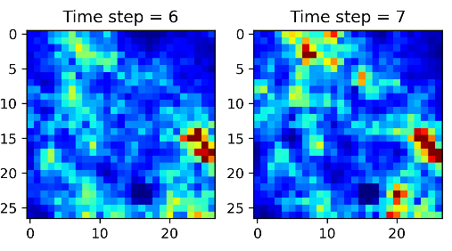
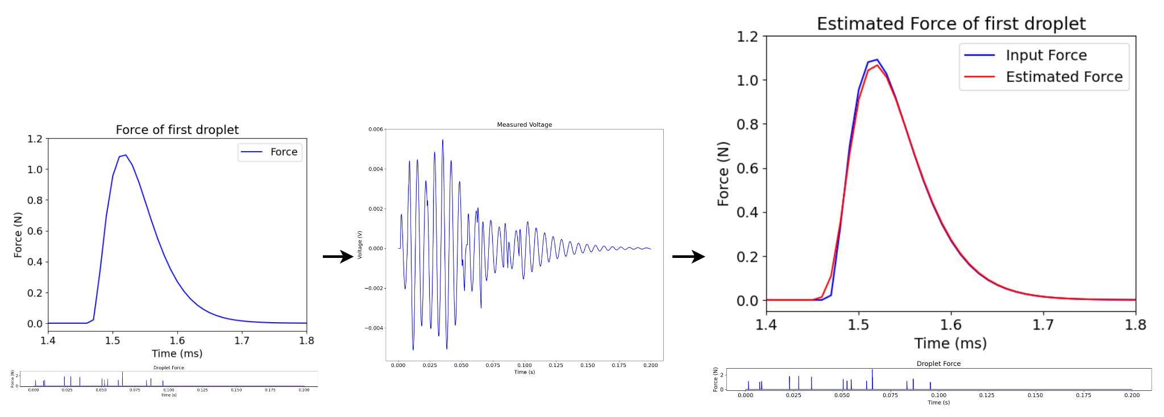
Track 3: Unconventional environmental modelling
非傳統環境監測解決方案開發
Extreme rainfall monitoring network with cutting-edge sensors
Innovative river health monitoring solutions using AI
Low-cost environmental sensor development
https://doi.org/10.3389/fenvs.2024.1371048
https://www.wrcgroup.com/headlines/corporate/thousands-of-citizen-photos-train-ai-to-monitor-river-pollution/
https://doi.org/10.5194/egusphere-egu24-5947

Slide 9
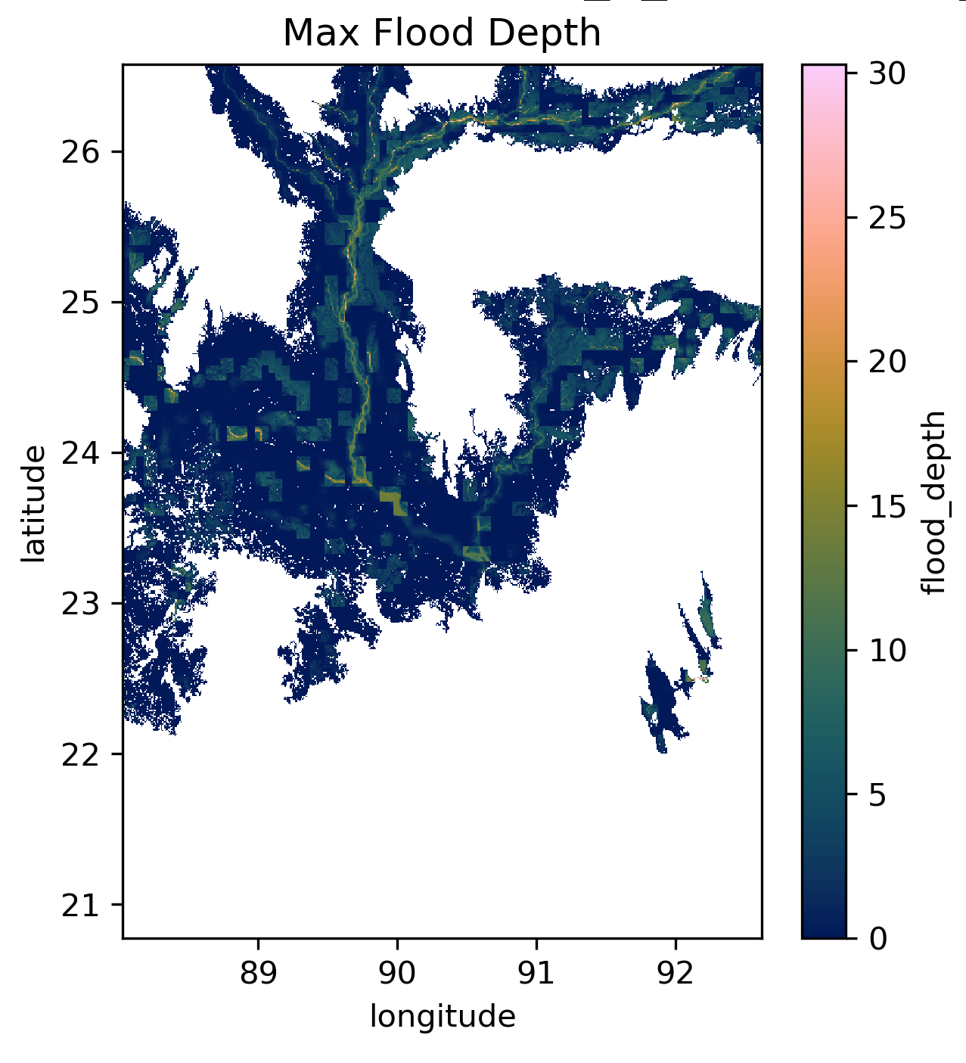
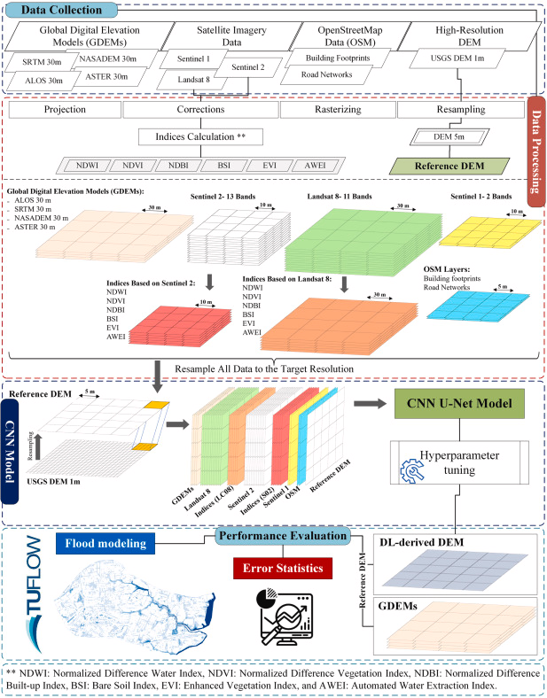
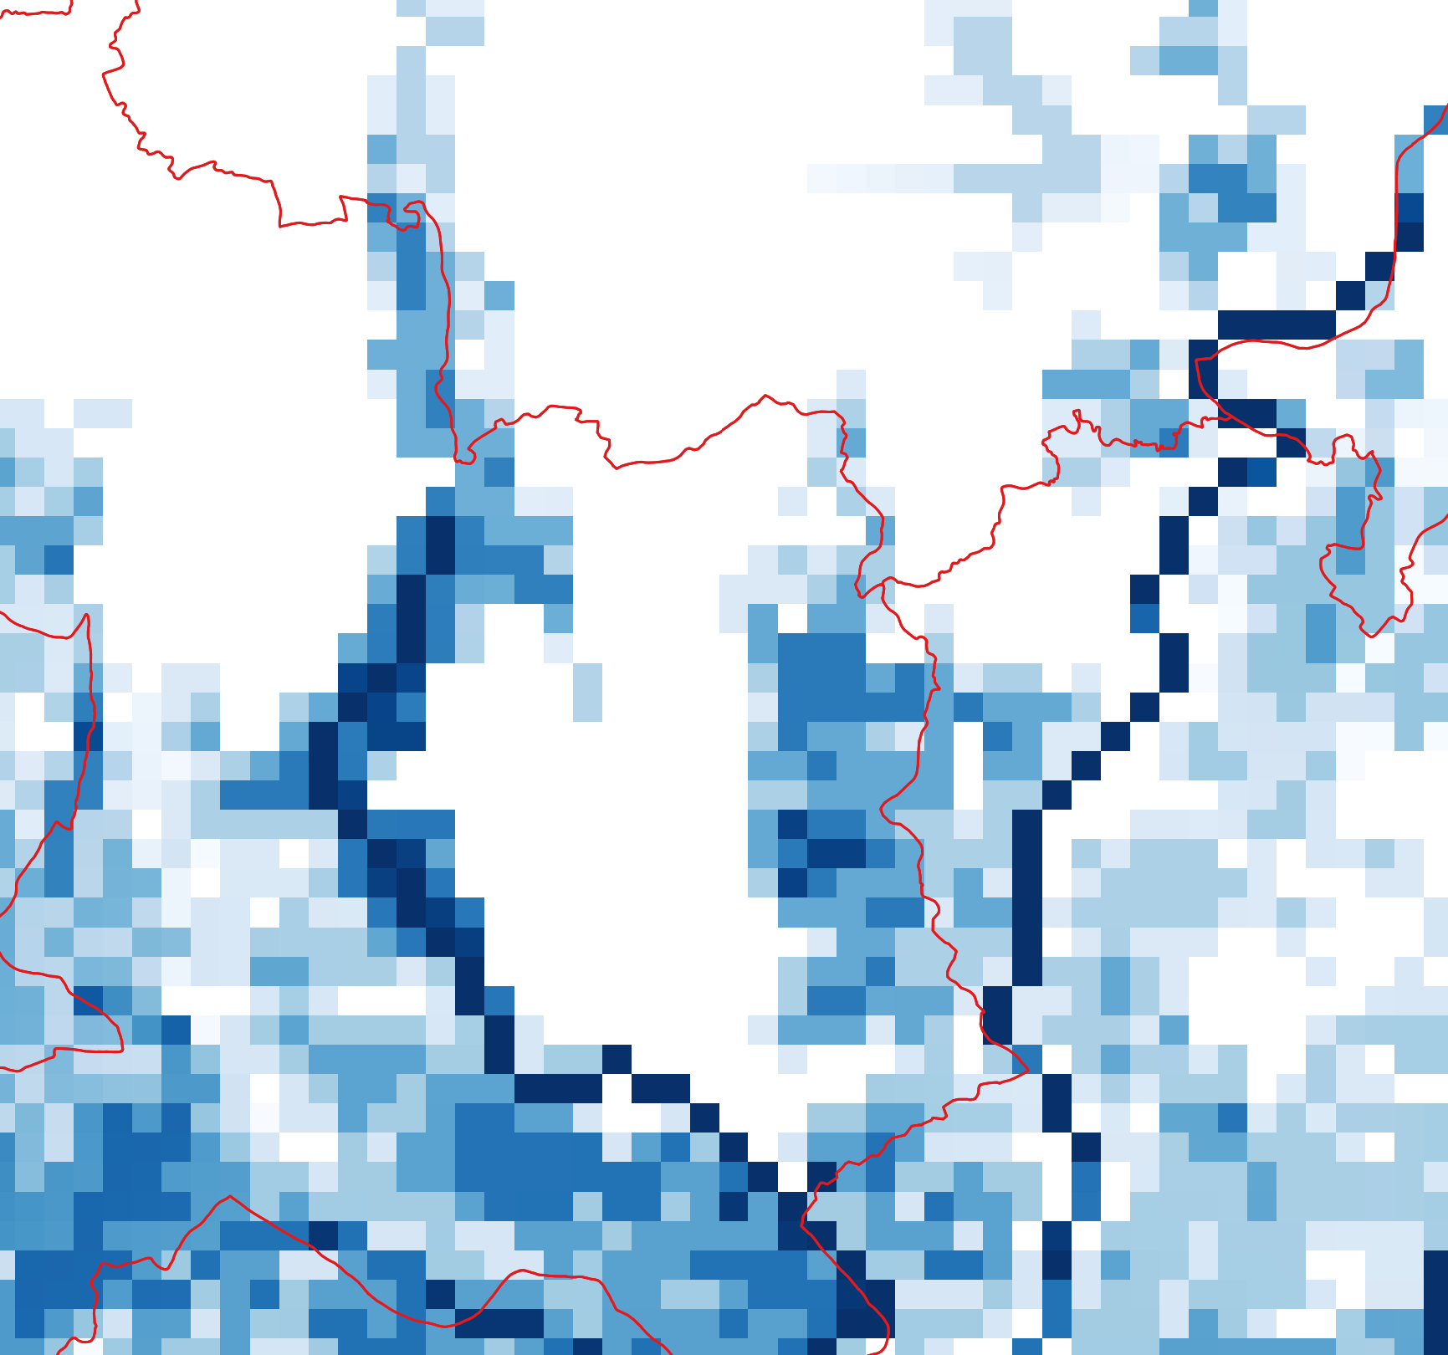
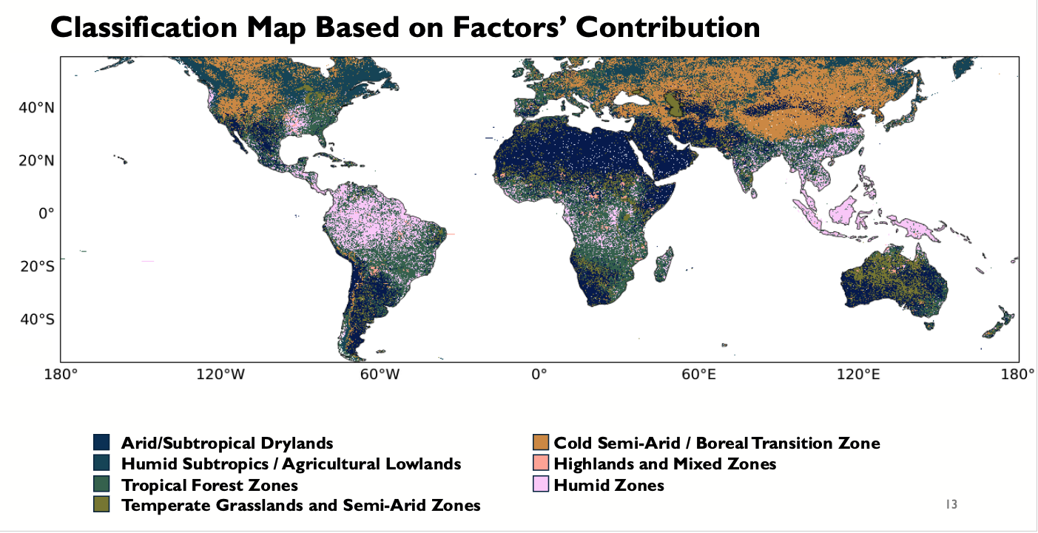
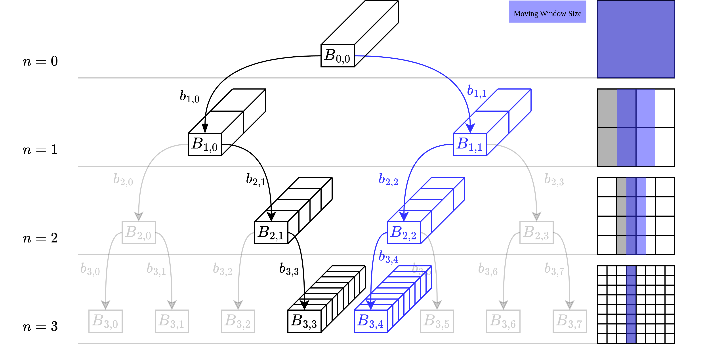
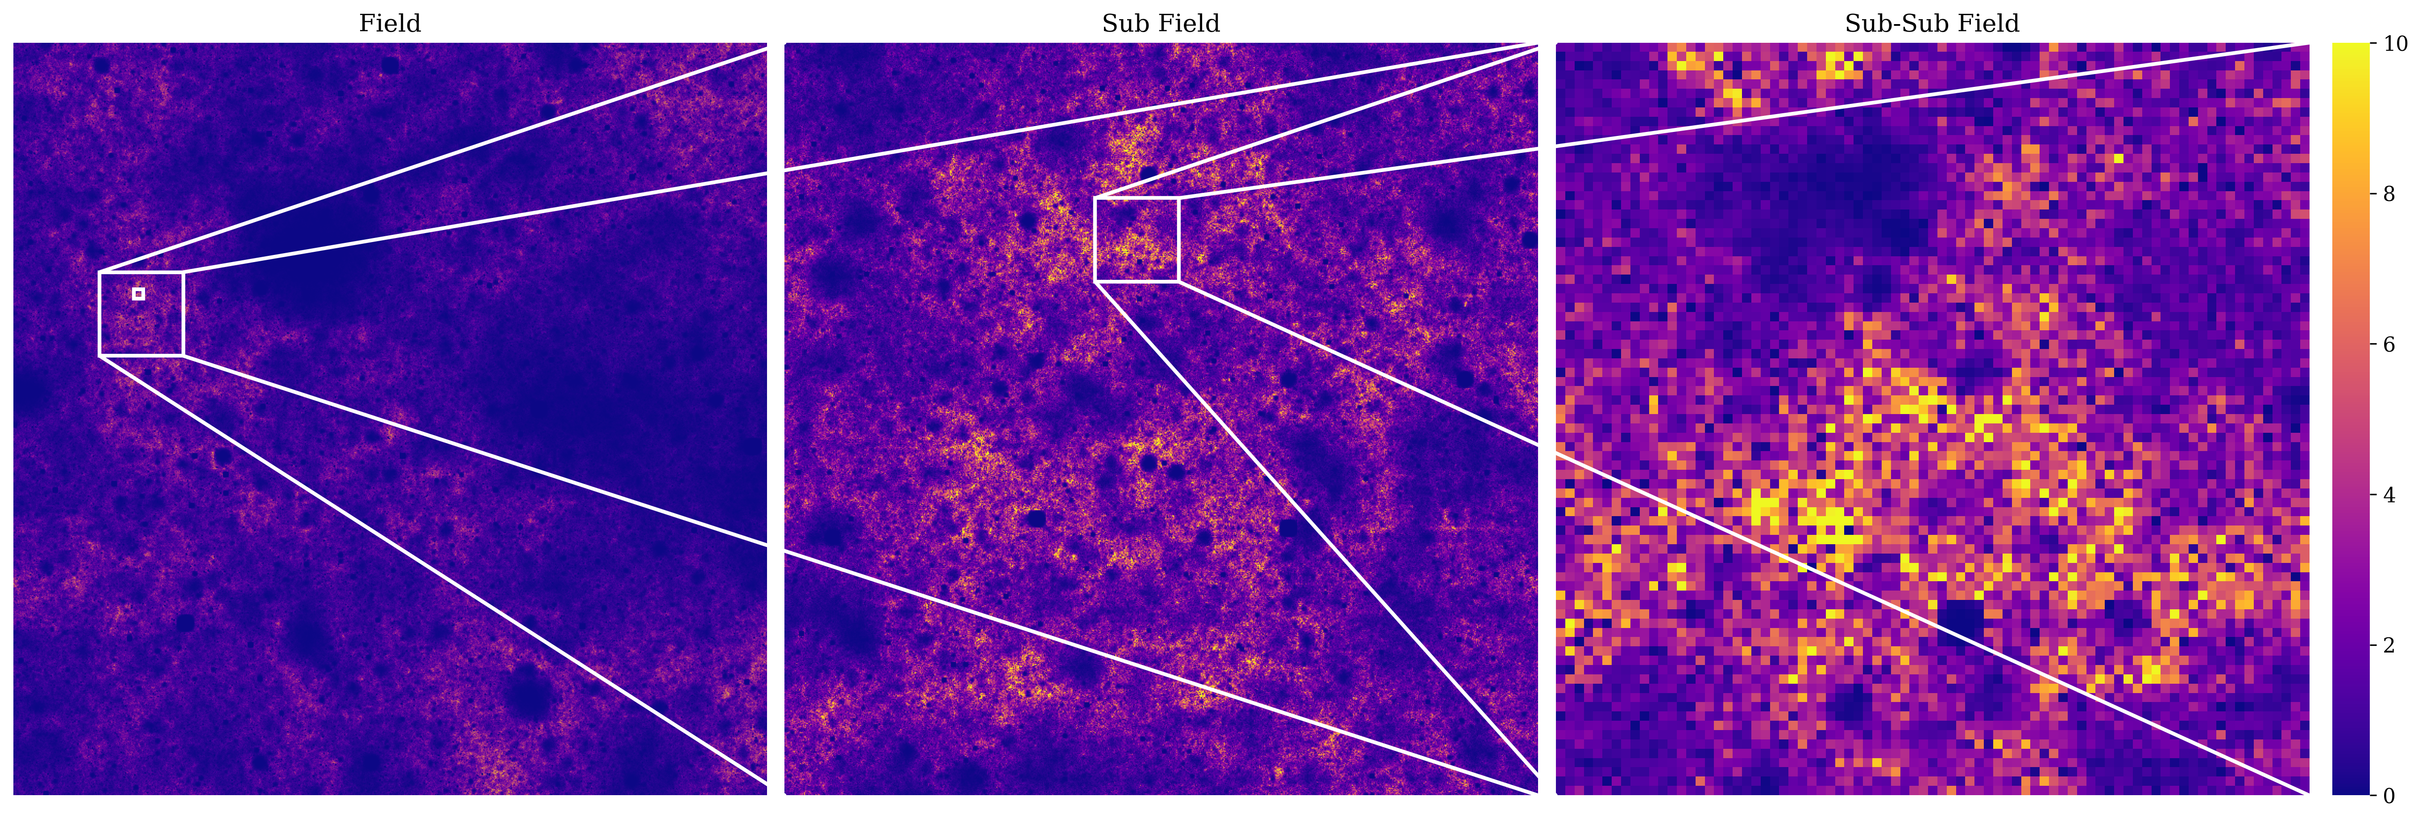
Track 3: Research Challenges
How to deploy AI-based solutions in real-world operations?
How to integrate observations from multiple sources across multiple scales and scale up to global solutions?
https://doi.org/10.1016/j.jhydrol.2025.132687

Slide 10
Beyond research
WangUp Core Culture
Openness: Open Data & Open Source; research outcomes shared as tools & teaching materials
Skill Training: Technical capacity building & knowledge transfer
Global Impact: Solutions applicable worldwide.
Hard & Soft Skills
Technical expertise + teamwork, leadership, communication
Internal workshops & hackathons, international conferences, overseas exchange
Expand global perspectives & cross-cultural collaboration
Li-Pen Wang (lpwang@ntu.edu.tw)

